Slide 1

Machine Vision CHC6781
Lecture 3:
Loss Functions and Optimization
Module Leader: Dr Happy N. Monday
Contact via:
Email: happy.monday@zy.cdut.edu.cn
Office: Room 8102

Slide 2

Class Rules
Be on time
Bring your stuff (Pen, papers, folder, brain)
No pressing of phone, or gaming in the class.
Habit of Effective learners.
Prepare for your coursework and exam on time.
Always revise your PPTs before and after class.
Have Fun

Slide 3
Learning Outcomes
Familiarity with different loss functions equips students with the ability to choose the appropriate loss function based on the nature of the problem they are addressing.
By the end of this topic, students should be able to select an appropriate loss function for a given task and comprehend its significance in model optimization.
Understanding optimization methods is crucial for efficiently training machine learning models.
By the end of this topic, students should be able to identify and apply suitable optimization techniques based on the problem and dataset.
Familiarity with SGD introduces students to a widely used optimization technique suitable for large datasets, improving their efficiency in training complex models.

Slide 4
References
1. Richard Szeliski. (2017). Computer Vision: Algorithms and Applications. Springer
2. Géron, A. (2019). Hands-On Machine Learning with Scikit-Learn, Keras, and TensorFlow. O'Reilly Media.
3. Aggarwal, C.C. (2018). Neural Networks and Deep Learning. Springer
4. Goodfellow, I., Bengio, Y., & Courville, A. (2016). Deep Learning. MIT Press.
5. Hastie, T., Tibshirani, R., & Friedman, J. (2009). The Elements of Statistical Learning: Data Mining, Inference, and Prediction. Springer.
Gulli, A, Pal, S. (2017). Deep Learning with Keras. Packt Publishing
Montavon, G. Orr, G. Muller, K.K. (2012). Neural Networks: Tricks of the Trade. Springer.

Slide 5
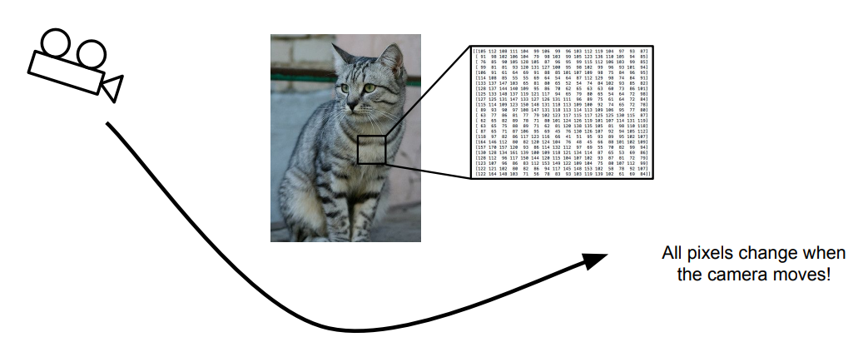
Recall from the last class: Problems of Recognition
Viewpoint Variation

Slide 6
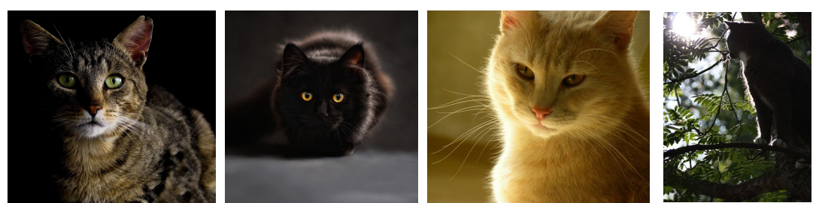
Recall from the last class: Problems of Recognition
Illumination

Slide 7
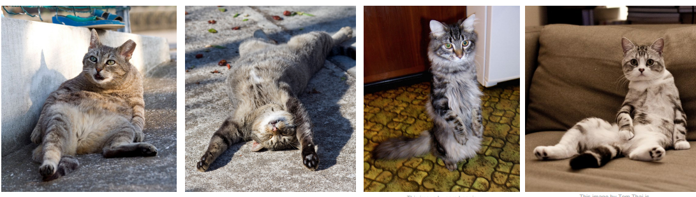
Recall from the last class: Problems of Recognition
Deformation

Slide 8
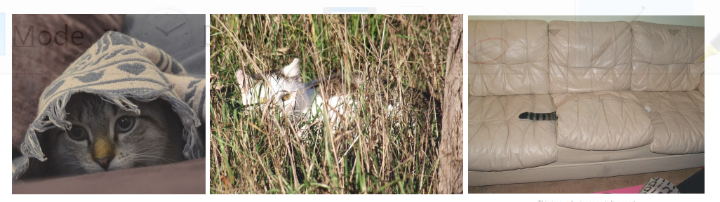
Recall from the last class: Problems of Recognition
Occlusion

Slide 9
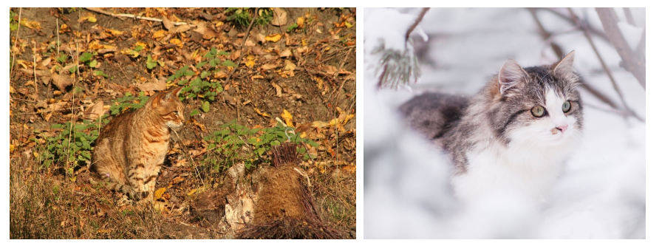
Recall from the last class: Problems of Recognition
Background Clutter

Slide 10
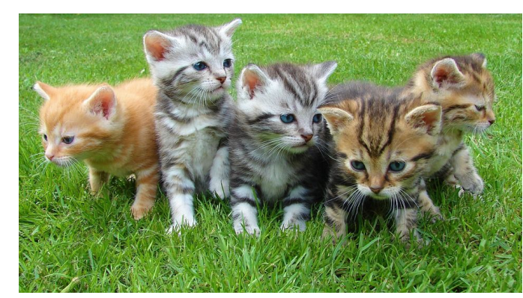
Recall from the last class: Problems of Recognition
Intraclass Variation

Slide 11
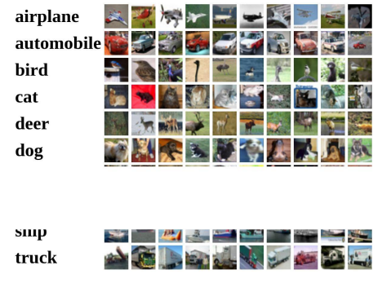
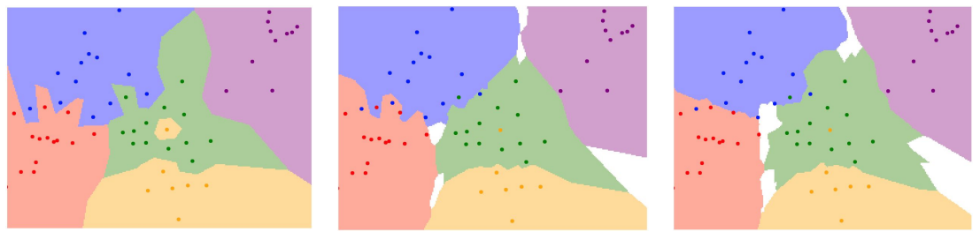
From the last class: Data-driven approach, KNN
K=1
K=5
Instead of copying label from nearest neighbor, take majority vote from K closest points
Train
Test
Train
Test
Validation

Slide 12
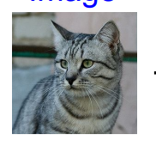
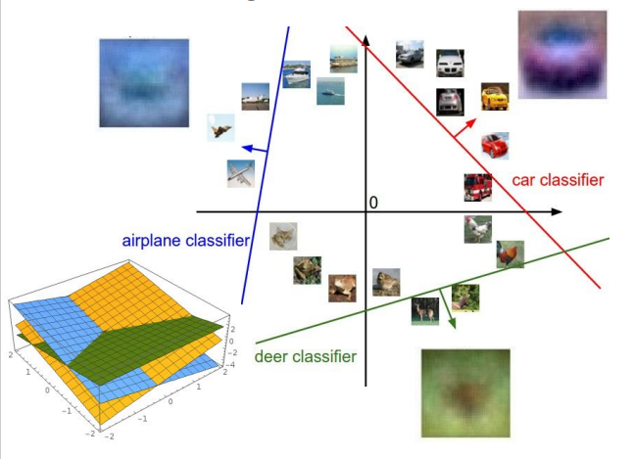
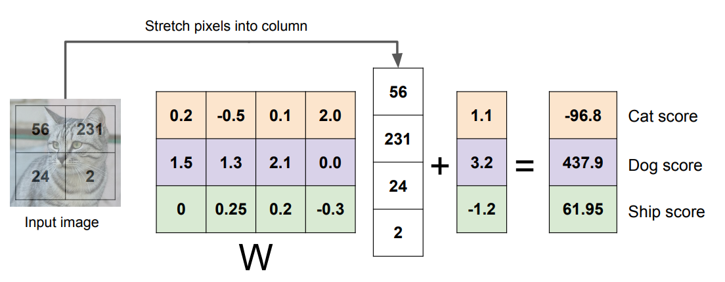
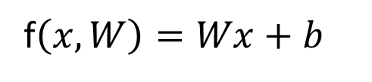
Recall from the last class: Linear Classifier
f(x,W)
3 categories, giving the class score
f$\left(x,W\right)=Wx+b$
W
Parameters or weights

Slide 13
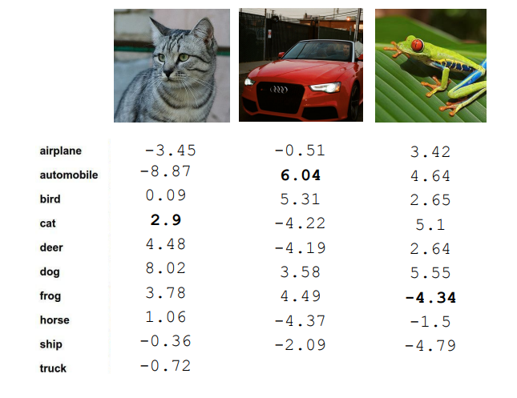
Recall from the last class: Linear Classifier
10 categories, giving the class score
TODO:
1. Define a loss function that quantifies our unhappiness with the scores across the training data.
2. Come up with a way of efficiently finding the parameters that minimize the loss function (Optimization)

Slide 14
Loss Function
The loss function is a method of evaluating how well the machine learning algorithm models the featured dataset. In order words, loss function are a measurement of how good the model is in terms of predicting the expected outcome.
A loss function measures the difference between predicted values and actual target values in a machine learning model.

Slide 15
Common Loss Function
Mean Squared Error (MSE): Measures the average squared difference between predicted and actual values.
Cross-Entropy Loss: Used in classification tasks to measure the dissimilarity between predicted class probabilities and actual one-hot encoded labels.
Mean Absolute Error (MAE): Measures the average absolute difference between predicted and actual values.

Slide 16
Common Loss Function Cont’d
Hinge loss: is a loss function used primarily in support vector machines for binary classification.
It is specifically designed to encourage the model to have a margin of separation between data points of different classes.
In binary classification, hinge loss penalizes misclassified examples linearly, and correctly classified examples receive a loss of zero if they are beyond a certain margin.
Hinge loss is commonly used in SVMs because it is convex, leading to efficient optimization and good generalization performance.

Slide 17
Common Loss Function Cont’d
SVM loss: is the loss function used in the soft-margin variant of the Support Vector Machine algorithm.
In SVM, the goal is to find a hyper-plane that separates the data into two classes while maximizing the margin between the two classes.
In practice, not all data points may be separable, so the soft-margin SVM allows some misclassification (soft constraints) to find a more flexible decision boundary.
The SVM loss function is a combination of the hinge loss and a regularization term (usually L2 norm of the model weights).

Slide 18
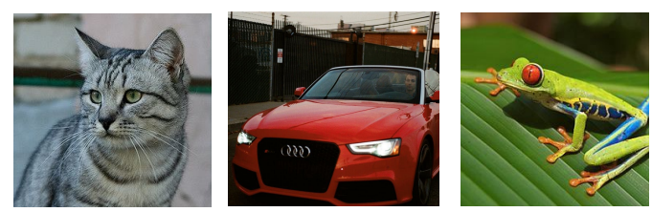
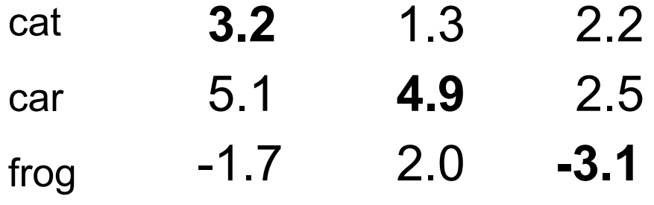
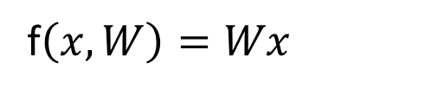
Loss Function
Suppose: 3 training examples, 3 classes.
With some ‘W’ , the score for
are:
f$\left(x,W\right)=Wx$

Slide 19
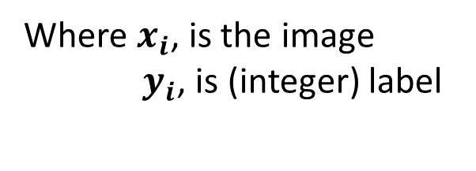
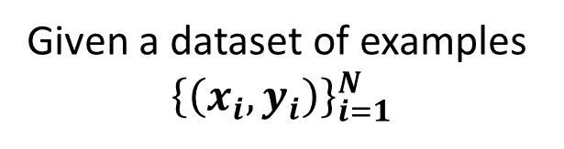
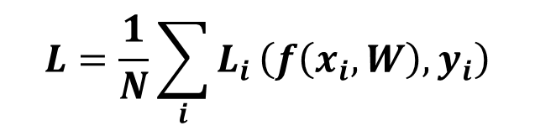
Loss Function
Suppose: 3 training examples, 3 classes.
With some ‘W’ , the score
are:
f$\left(x,W\right)=Wx$
A loss function tells how good our current classifier is
Given a dataset of examples
$${\left\{\left(x_{i},y_{i}\right)\right\}}_{i=1}^{N}$$
Where $x_{i}$, is the image
$y_{i}$, is (integer) label
Loss over the dataset is a sum of loss over examples:
$$L=\frac{1}{N}\sum_{i}{L_{i}}\left(f\left(x_{i},W\right),y_{i}\right)$$

Slide 20
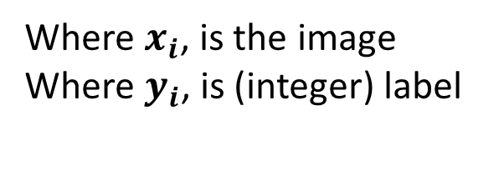
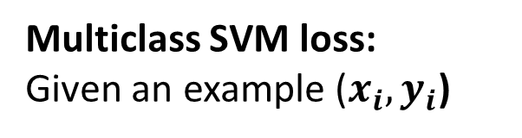
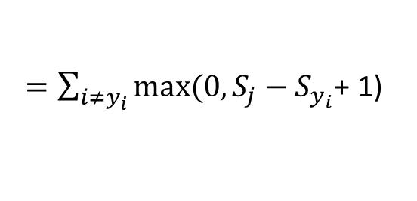
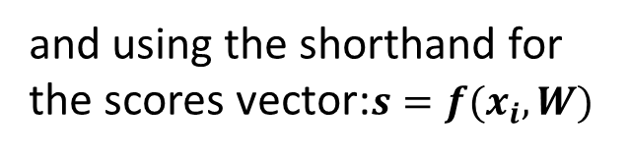
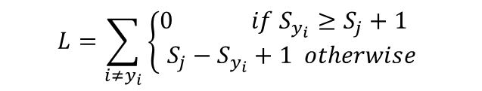
Loss Function
Suppose: 3 training examples, 3 classes.
With some ‘W’ , the score
are:
f$\left(x,W\right)=Wx$
Multiclass SVM loss:
Given an example ($x_{i},y_{i}$)
Where $x_{i}$, is the image
Where $y_{i}$, is (integer) label
and using the shorthand for the scores vector:$s=f(x_{i},W)$
The SVM loss has the form:
$$L=\sum_{i{≠y}_{i}}{\left\{\begin{aligned}0 if S_{y_{i}}≥S_{j}+1 \\ S_{j}−S_{y_{i}}+1 otherwise\end{aligned}\right.}$$
$=\sum_{i{≠y}_{i}}{max⁡(0, S_{j}−}$ $S_{y_{i}}$+ 1)

Slide 21
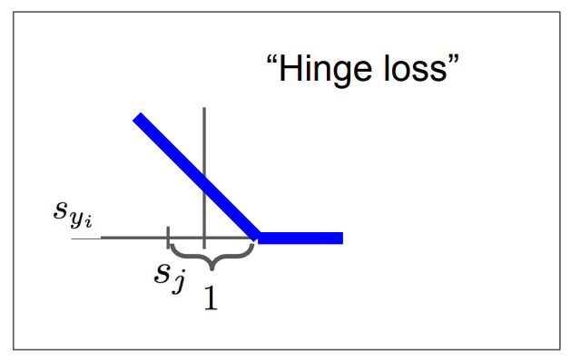
Loss Function
Suppose: 3 training examples, 3 classes.
With some ‘W’ , the score
are:
f$\left(x,W\right)=Wx$
Multiclass SVM loss:
$$L=\sum_{i{≠y}_{i}}{\left\{\begin{aligned}0 if S_{y_{i}}≥S_{j}+1 \\ S_{j}−S_{y_{i}}+1 otherwise\end{aligned}\right.}$$
$=\sum_{i{≠y}_{i}}{max⁡(0, S_{j}−}$ $S_{y_{i}}$+ 1)

Slide 22
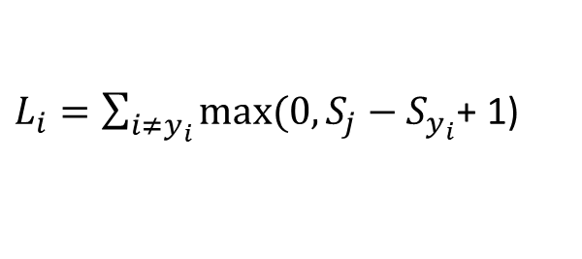
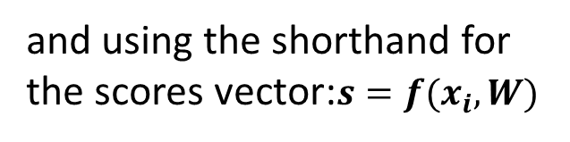
Loss Function
Suppose: 3 training examples, 3 classes.
With some ‘W’ , the score
are:
f$\left(x,W\right)=Wx$
Multiclass SVM loss:
Given an example ($x_{i},y_{i}$)
Where $x_{i}$, is the image
Where $y_{i}$, is (integer) label
and using the shorthand for the scores vector:$s=f(x_{i},W)$
The SVM loss has the form:
$L_{i}=\sum_{i{≠y}_{i}}{max⁡(0, S_{j}−}$ $S_{y_{i}}$+ 1)

Slide 23
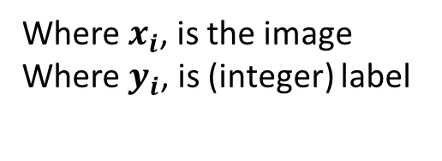
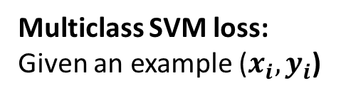
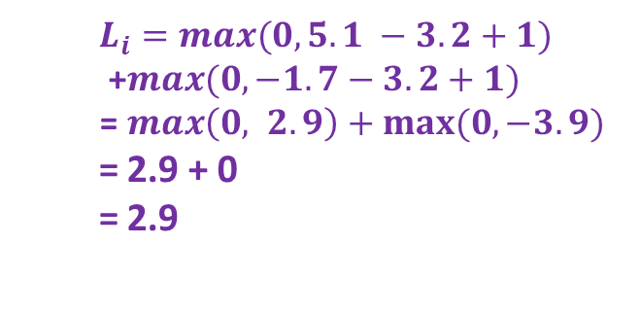
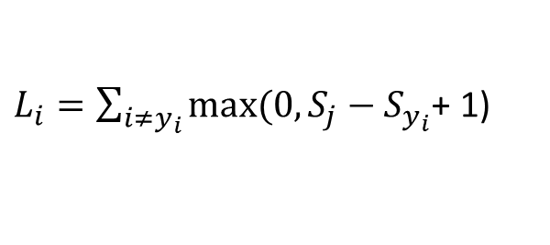
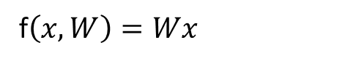
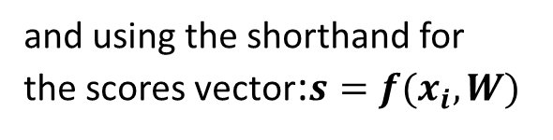
Loss Function
Multiclass SVM loss:
Given an example ($x_{i},y_{i}$)
Suppose: 3 training examples, 3 classes.
With some ‘W’ , the score
f$\left(x,W\right)=Wx$
are:
Where $x_{i}$, is the image
Where $y_{i}$, is (integer) label
and using the shorthand for the scores vector:$s=f(x_{i},W)$
The SVM loss has the form:
$L_{i}=\sum_{i{≠y}_{i}}{max⁡(0, S_{j}−}$ $S_{y_{i}}$+ 1)
$$L_{i}=max(0, 5.1 −3.2+1)$$
+$max(0,−1.7−3.2+1)$
= $max\left(0, 2.9\right)+max⁡(0, −3.9)$
= 2.9 + 0
= 2.9
Losses:
2.9

Slide 24
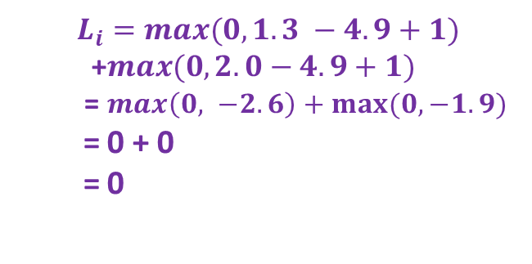
Loss Function
Multiclass SVM loss:
Given an example ($x_{i},y_{i}$)
Suppose: 3 training examples, 3 classes.
With some ‘W’ , the score
f$\left(x,W\right)=Wx$
are:
Where $x_{i}$, is the image
Where $y_{i}$, is (integer) label
and using the shorthand for the scores vector:$s=f(x_{i},W)$
The SVM loss has the form:
$L_{i}=\sum_{i{≠y}_{i}}{max⁡(0, S_{j}−}$ $S_{y_{i}}$+ 1)
$$L_{i}=max(0, 1.3 −4.9+1)$$
+$max(0, 2.0−4.9+1)$
= $max\left(0, −2.6\right)+max⁡(0, −1.9)$
= 0 + 0
= 0
Losses:
2.9
0

Slide 25
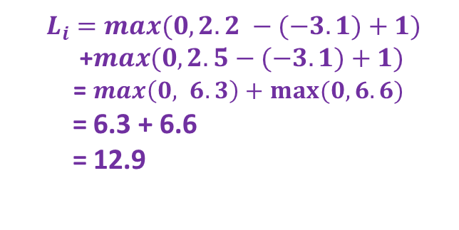
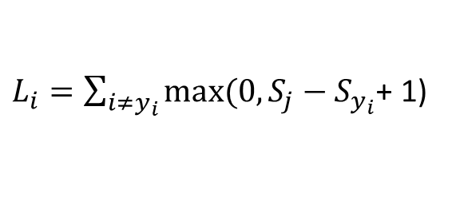
Loss Function
Multiclass SVM loss:
Given an example ($x_{i},y_{i}$)
Suppose: 3 training examples, 3 classes.
With some ‘W’ , the score
f$\left(x,W\right)=Wx$
are:
Where $x_{i}$, is the image
Where $y_{i}$, is (integer) label
and using the shorthand for the scores vector:$s=f(x_{i},W)$
The SVM loss has the form:
$L_{i}=\sum_{i{≠y}_{i}}{max⁡(0, S_{j}−}$ $S_{y_{i}}$+ 1)
$$L_{i}=max(0, 2.2 −(−3.1)+1)$$
+$max(0, 2.5−(−3.1)+1)$
= $max\left(0, 6.3\right)+max⁡(0, 6.6)$
= 6.3 + 6.6
= 12.9
Losses:
2.9
0
12.9

Slide 26
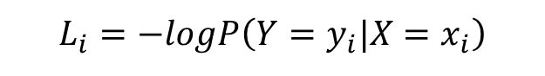
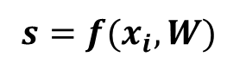
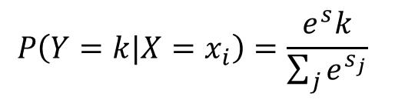
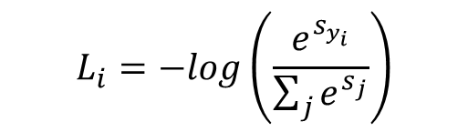
Cross Entropy Loss (Softmax)
Scores = unnormalized log probabilities of the classes.
$$P\left(Y=k|X=x_{i}\right)=\frac{e^{s}k}{\sum_{j}{e^{s_{j}}}}$$
where
$$s=f(x_{i},W)$$
Want to maximize the log likelihood, or (for a loss function) to minimize the negative log likelihood of the correct class:
$$L_{i}=−logP\left(Y=y_{i}|X=x_{i}\right)$$
$$L_{i}=−log\left(\frac{e^{s_{y_{i}}^{}}}{\sum_{j}{e^{s_{j}}}}\right)$$
In summary

Slide 27
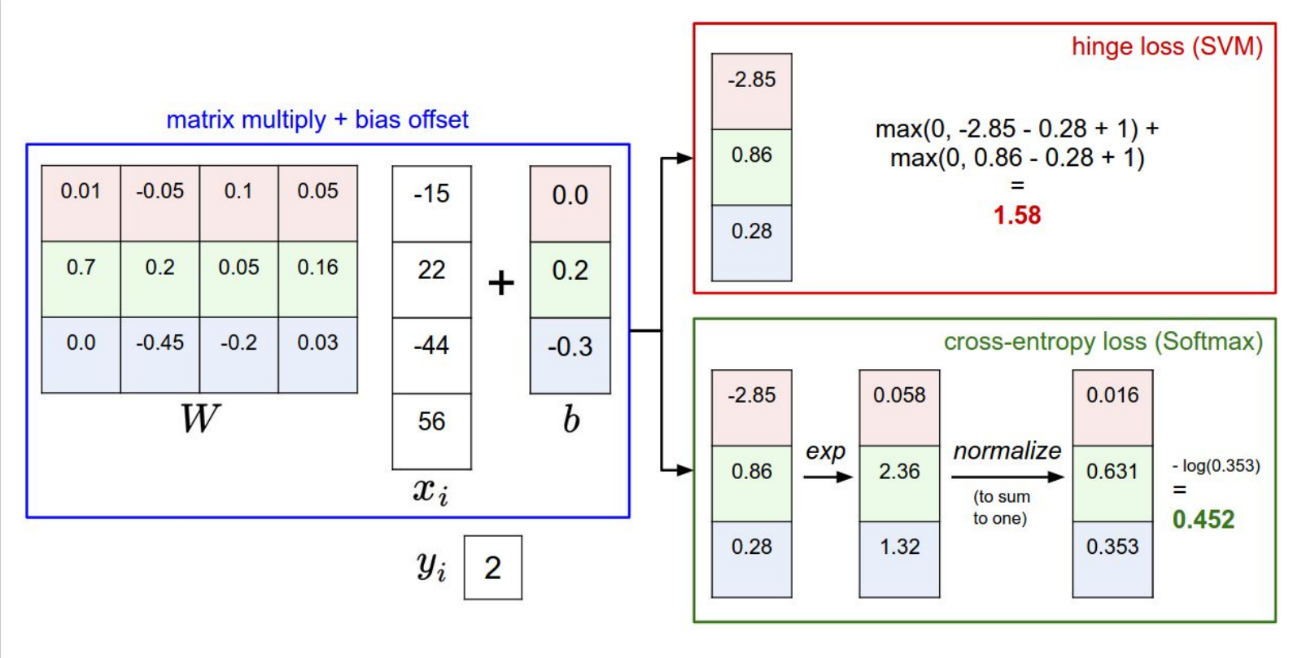
Loss Function and Classifier

Slide 28
Optimization

Slide 29
Optimization
Definition: Optimization is the process of finding the best set of model parameters that minimize the loss function and improve the model's performance.
Types of Optimization Algorithms
Gradient Descent
Stochastic Gradient Descent (SGD)
Batch Gradient Descent

Slide 30
Gradient Descent Algorithm
Definition: Gradient descent is an iterative optimization algorithm that updates the model parameters in the direction of steepest descent of the loss function.
It is an optimization algorithm to find the minimum of a function.
It starts with a random point on the function and move in the negative direction of the gradient of the function to reach the local or global minima.

Slide 31
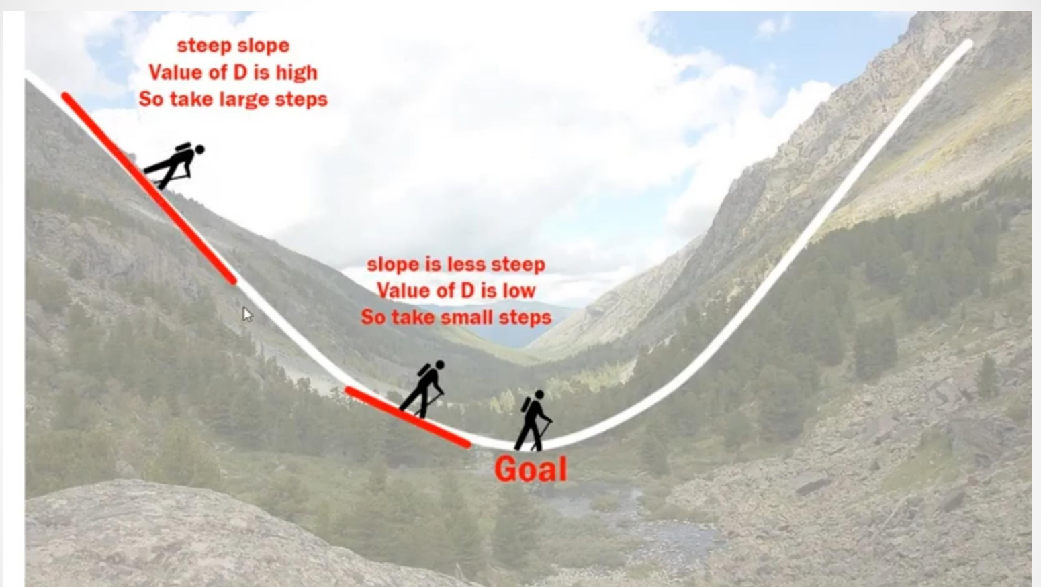
Gradient Descent Algorithm

Slide 32
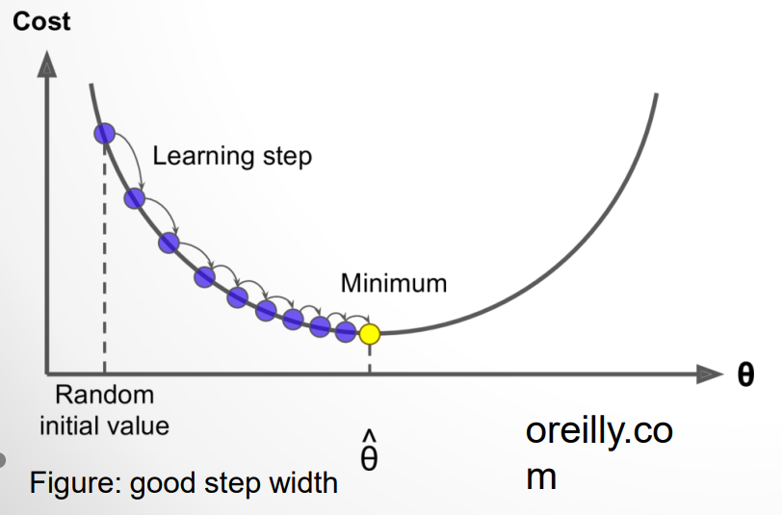
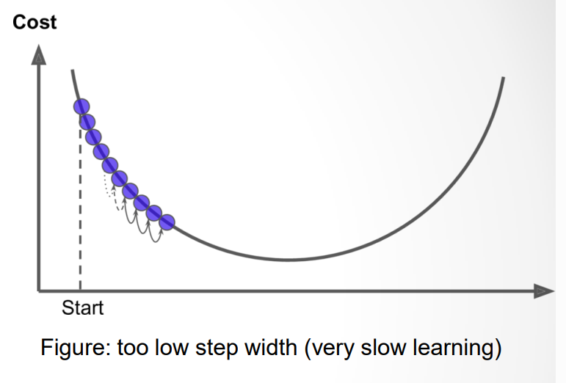
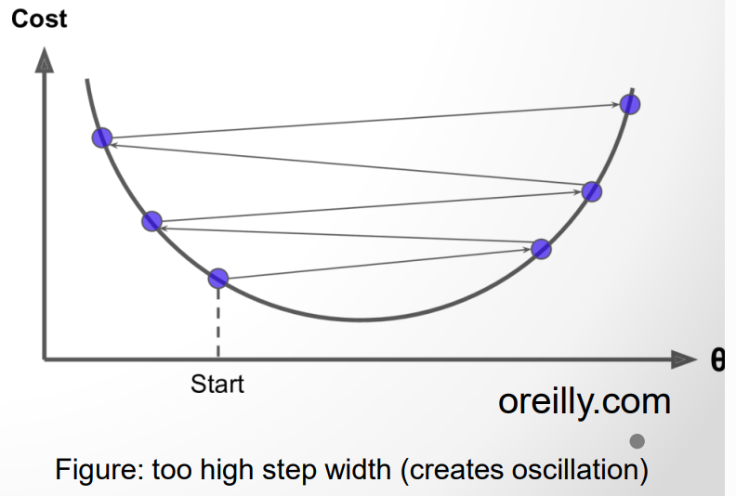
Learning Rate
Definition: The learning rate controls the step size of parameter updates during optimization. A larger learning rate may lead to faster convergence but risks overshooting the optimal solution, while a smaller rate may slow down convergence.

Slide 33
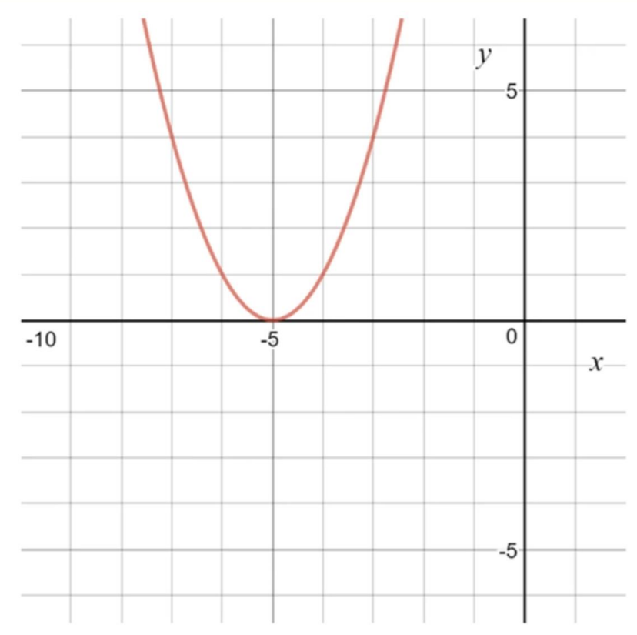
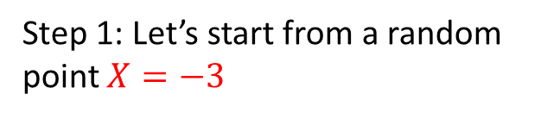
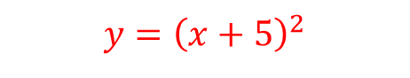
Gradient Descent Example
$$y={\left(x+5\right)}^{2}$$
Step 1: Let’s start from a random point $X=−3$

Slide 34
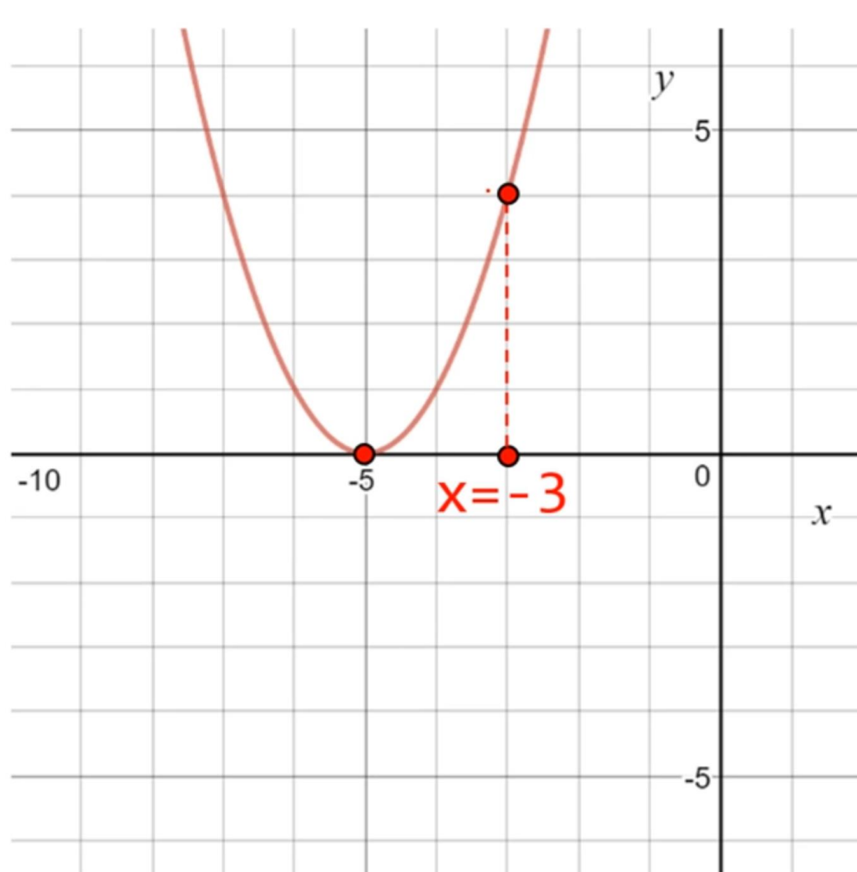
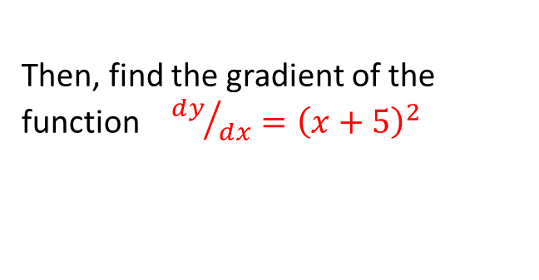
Gradient Descent Example
$$y={\left(x+5\right)}^{2}$$
Step 1: Let’s start from a random point $X=−3$
Then, find the gradient of the function ${ⅆy}/{ⅆx}={\left(x+5\right)}^{2}$

Slide 35
Gradient Descent Example
$$y={\left(x+5\right)}^{2}$$
Step 1: Let’s start from a random point $X=−3$
Then, find the gradient of the function ${ⅆy}/{ⅆx}={\left(x+5\right)}^{2}$
Step 2: Move in the direction of the negative of the gradient
How much to move depends on the learning rate.

Slide 36





Gradient Descent Example
$$y={\left(x+5\right)}^{2}$$
Step 3: Perform 2 iterations of gradient descent.
# Initialize Parameters
$X_{0}=−3$Learning_rate=0.01
$${ⅆy}/{ⅆx}=2\left(x+5\right)$$
Iteration 1:
$${X_{1}=X}_{0} −\left(learning_rate\right)×\left({ⅆy}/{ⅆx}\right)$$
$$X_{1}=\left(−3\right)−\left(0.01\right)×2\left(\left(−3\right)+5\right)=−3.04$$
Iteration 2:
$${X_{2}=X}_{1} −\left(learning_rate\right)×\left({ⅆy}/{ⅆx}\right)$$

Slide 37





Gradient Descent Example
Step 3: Perform 2 iterations of gradient descent.
$$y={\left(x+5\right)}^{2}$$
# Initialize Parameters
$X_{0}=−3$Learning_rate=0.01
$${ⅆy}/{ⅆx}=2\left(x+5\right)$$
Iteration 1:
$${X_{1}=X}_{0} −\left(learning_rate\right)×\left({ⅆy}/{ⅆx}\right)$$
$$X_{1}=\left(−3\right)−\left(0.01\right)×2\left(\left(−3\right)+5\right)=−3.04$$
Iteration 2:
$${X_{2}=X}_{1} −\left(learning_rate\right)×\left({ⅆy}/{ⅆx}\right)$$
$$X_{2}=\left(−3.04\right)−\left(0.01\right)×2\left(\left(−3.04\right)+5\right)=−3.0792$$

Slide 38

Gradient Descent Example
$$y={\left(x+5\right)}^{2}$$
For we to get to the global minimum which is x = -5, we need to perform more iterations using same value for the learning rate.
Large step widths or learning rate may help
Too large rates cause overshooting and instability

Slide 39
Gradient Descent
Most common error minimization in machine learning
Virtually any problem allows to derive a gradient
Can deal with many parameters (e.g. In neural networks)

Slide 40
The End!

